Slide 1
GPUs and CUDA 1 Threading
CS121 Parallel Computing
Fall 2024

Slide 2


A brief history
Graphics processing units (GPU) originally used to speed up 3D games.
Need high throughput (lots of pixels), but parallelism abundant (compute pixels independently).
Fancier games required programmable “pixel shaders”.
Around 2006, Nvidia introduced Tesla, a programmable, general purpose GPU (GPGPU).
GPUs now essential in machine learning, big data and HPC. Large amounts of research.
GPUs have TFLOPS of performance, “supercomputer on a chip”.
Also more energy efficient than CPUs, which is increasingly important.

Slide 3
Latency vs throughput
time
Up to now we looked at message passing and shared memory parallel computing using standard multicore processors.
Multicore processors have a few cores, and try to minimize latency on each core.
Throughput oriented parallel processors do each task slower, but have many cores, and so can do many tasks in parallel.
Throughput processors can do more work per unit time.
P1
P2
low latency
P1
P2
...
Pn
high throughput

Slide 4
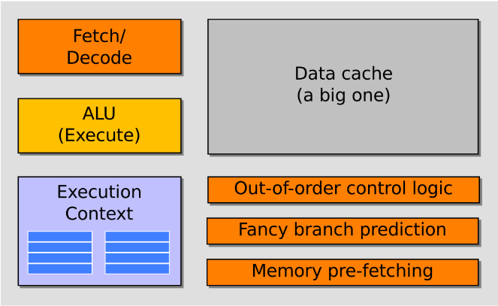
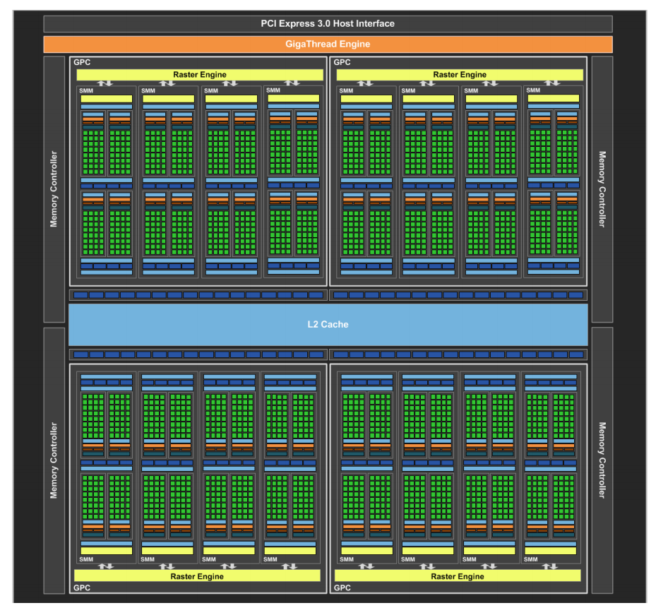
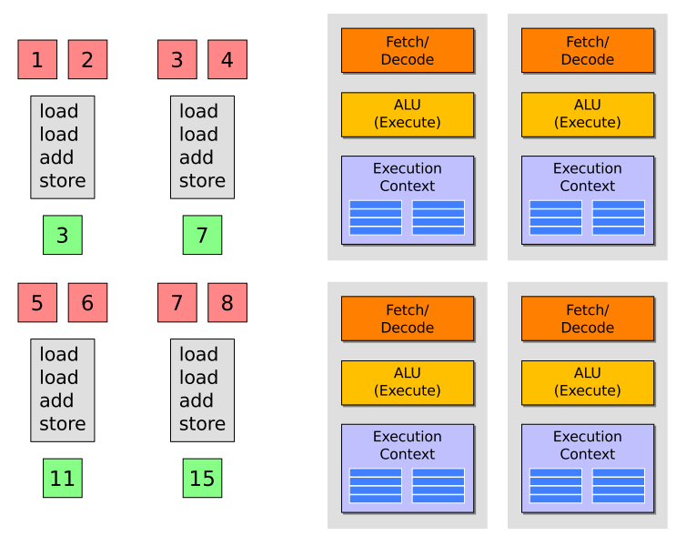
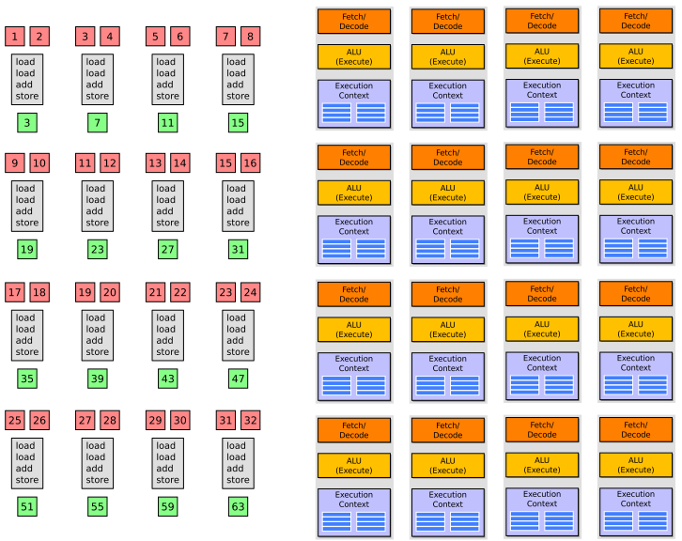
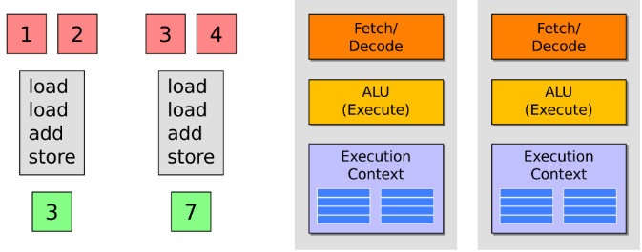
GPU vs CPU architecture
CPU has many complex features to lower latency.
Consumes lots of die space.
Less space for compute units.
GPU only has basic processor units, and shares them among the cores.
Each core slower.
But lots of them.
Nvidia H100 has 132 SMs and 128 cores per SM.
Runs 16896 threads simultaneously, 67 TFLOPS of FP32 performance.
80 GB of memory, 3.35 TB/s of bandwidth.
AMD Ryzen Threadripper PRO 7995 runs 192 threads simultaneously, 12 TFLOPS of FP32.

Slide 5
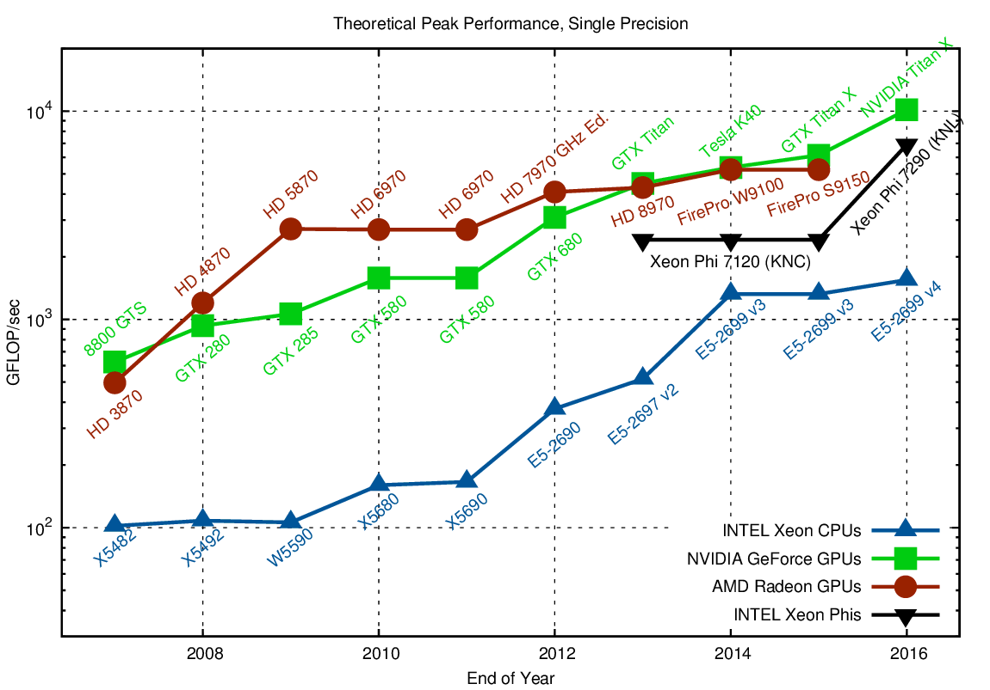

The right choice(?)
GPUs >10 times faster than CPUs for many problems.
Even more speedup for specialized applications.
GPUs also much more energy efficient.
Frontier (1.2 exaflops) uses 37,888 Radeon Instinct MI250X GPUs.
Best for data parallel tasks.
GPU is based on SIMD architecture.
Less effective for irregular computations (branching, synchronization).
Source: https://www.karlrupp.net/2013/06/cpu-gpu-and-mic-hardware-characteristics-over-time/

Slide 6
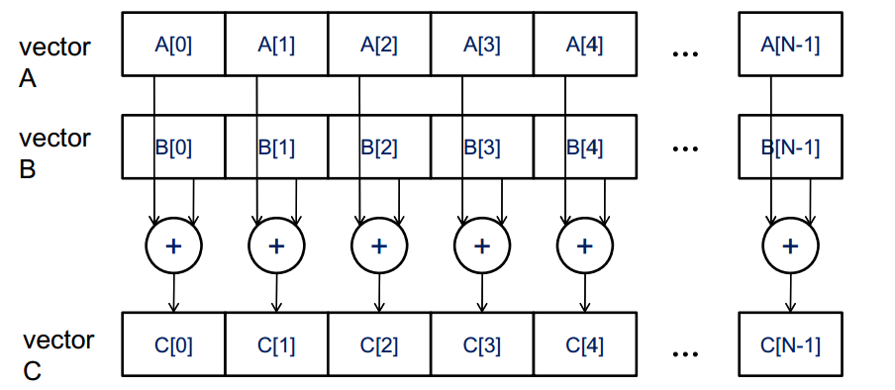
Data parallelism
Apply same operation to multiple data items.
Vector addition.
Linear algebra (matrix-vector, matrix-matrix multiplication).
Computer graphics.
Data analysis (convolutions, FFT).
Finite elements.
Simulations.
“Big data”, data mining and machine learning.

Slide 7
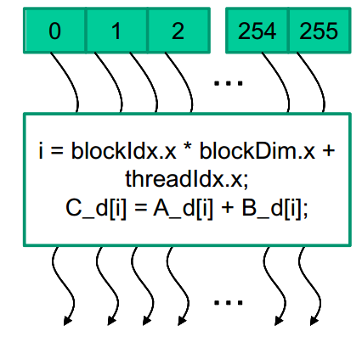
GPU example: vector addition
Sequential program iterates through the elements.
void vecAdd(float* A, float* B, float* C, int n)
{
for (i = 0, i < n, i++)
C[i] = A[i] + B[i];
}
GPU kernel launches many threads, one for each vector element.
Potentially millions of threads.
Hardware ensures low (almost zero) overhead thread management.
__global__
void vecAddKernel(float* A_d, float* B_d, float* C_d, int n)
{
int i = threadIdx.x + blockDim.x * blockIdx.x;
if(i<n) C_d[i] = A_d[i] + B_d[i];
}

Slide 8
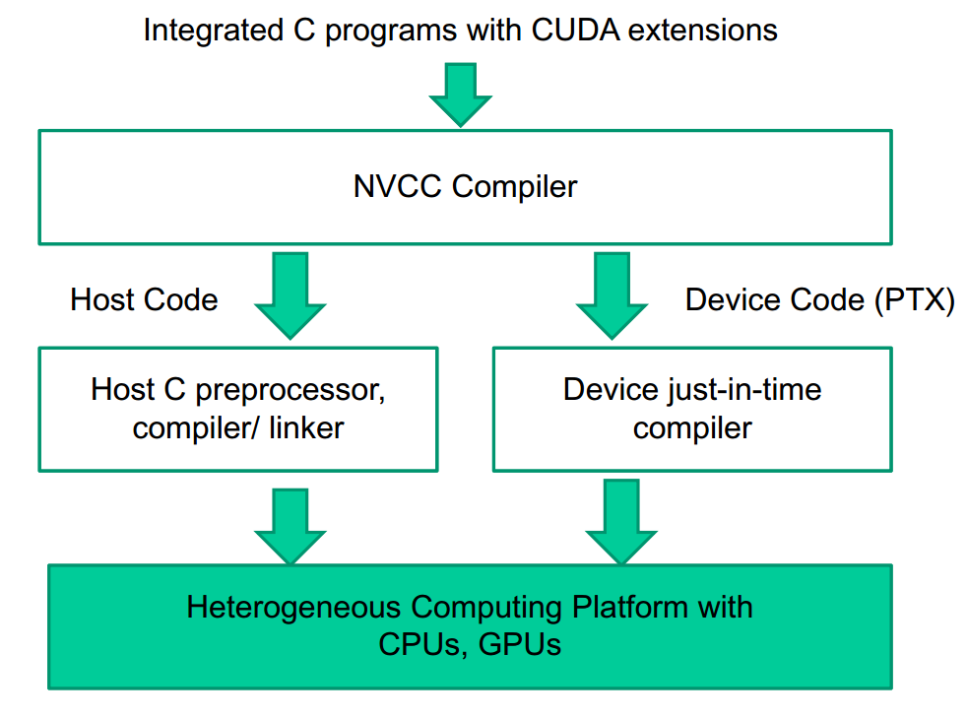
CUDA
Compute Unified Device Architecture.
Easily use GPU as coprocessor for CPU.
Popular Nvidia platform for programming GPUs.
An extension of C language.
Compiler, debugger, profilers provided.
Other platforms include OpenCL and OpenACC.
OpenCL is similar CUDA, but more portable.
Same source code can be compiled for GPUs, CPUs, FPGAs, etc.
Somewhat lower performance than CUDA.
OpenACC similar to OpenMP, i.e. write GPU code using simple directives.
Compiler takes care of parallelization.
Significantly lower performance than CUDA.

Slide 9
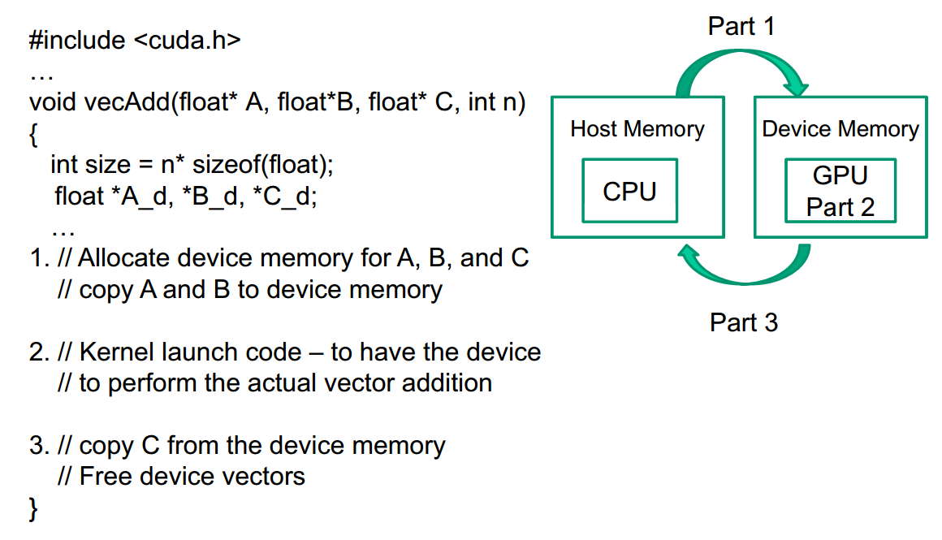
CUDA steps
Write C program with CUDA annotations and compile.
Start CUDA program on host (CPU).
Run mostly serial parts on host.
For parallel part
Allocate memory on device (GPU).
Transfer data to device.
Specify number of device threads.
Invoke device kernel.
Can pass control back to CPU and repeat.
. . .
. . .

Slide 10
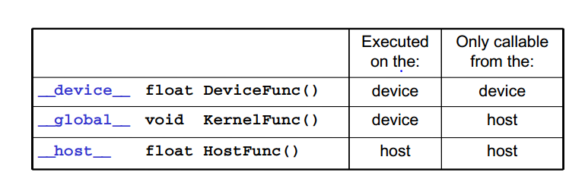
CUDA functions
Use labels to declare host and device functions.
Allocate memory on device.
cudaMalloc((void **) &x, size)
Transfer memory.
Let x be some host data and d_x be a pointer to device memory.
From host to device (send input).
cudaMemcpy(d_x, x, size, cudaMemcpyHostToDevice)
From device to host (receive output).
cudaMemcpy(x, d_x, size, cudaMemcpyDeviceToHost)

Slide 11
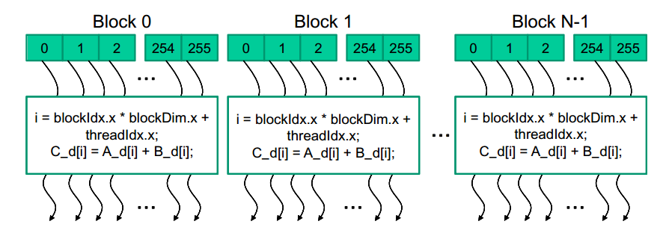
CUDA functions
When calling kernel, must specify number of threads.
Threads grouped into blocks.
Specify number of blocks, and number of threads per block.
Invoke kernel.
Let n be total # threads, t be # threads per block.
Start ceil(n/t)thread blocks with t threads each.
KernelFunction<<<ceil(n/t), t>>>(args)
ceil ensures we have at least n threads.

Slide 12
Vector addition code
__global__
void vecAddKernel(float* A, float* B, float* C, int n) {
int i = threadId.x + blockDim.x * blockId.x;
if (i<n) C[i] = A[i] + B[i];
}
void vecAdd(float* A, float* B, float* C, int n) {
int size = n * sizeof(float);
float *d_A, *d_B, *d_C;
cudaMalloc((void **) &d_A, size);
cudaMemcpy(d_A, A, size, cudaMemcpyHostToDevice);
cudaMalloc((void **) &d_B, size);
cudaMemcpy(d_B, B, size, cudaMemcpyHostToDevice);
cudaMalloc((void **) &d_C, size);
vecAddKernel<<<ceil(n/256), 256>>>(d_A, d_B, d_C, n);
cudaMemcpy(C, d_C, size, cudaMemcpyDeviceToHost);
cudaFree(d_A); cudaFree(d_B); cudaFree(d_C);
}
int main() {
vecAdd(A_h, B_h, C_h, N);
}

Slide 13
CUDA thread organization
All CUDA threads run the same code.
But they can operate on different data based on their thread ID.
They can also be at different points in the code.
Threads are organized in two levels.
A “grid” containing multiple thread blocks.
Each thread block contains a number of threads.
All blocks have same size (i.e. number of threads).
Grid and blocks can be 1D, 2D or 3D. Let’s look at 1D first.
Will discuss reason for having two levels later.

Slide 14
1D thread mapping
When kernel is started, all threads assigned a unique (block number, thread number within its block).
So we can uniquely identify a thread by its (blockId.x, threadId.x).
Number of threads in a block = blockDim.x.
Ex For vector addition, want every element to be processed by a thread.
Let’s map thread (blockId.x, threadId.x) to vector element
blockId.x * blockDim.x + threadId.x
Ex Block size 256. Thread 23 in block 3 maps to element 3*256+23 = 791.
Each thread mapped to a different element.
Every element from 0 to n-1 assigned a thread.
Other mappings also possible, depending on problem requirements.
KernelFunction<<<ceil(n/t), t>>>(args)

Slide 15
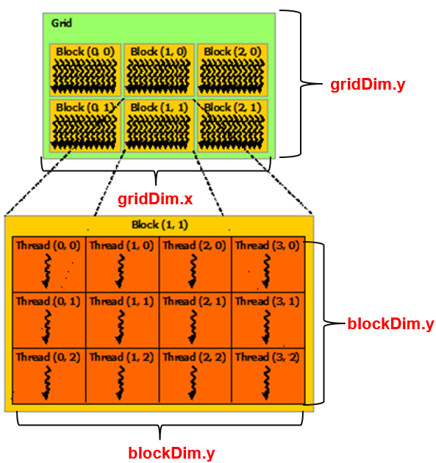
Multidimensional thread organization
Since vectors are 1D, natural to use 1D thread organization.
For 2D (matrices, computer graphics, etc) and 3D (volumetric, 2D + time) data, more natural to use 2D or 3D thread organization.
The grid of thread blocks can be 1D, 2D or 3D.
Each thread block within a grid can also be 1D, 2D or 3D.
The grid and thread block dimensions don’t have to be equal.
Grid and block size should be power of 2.
Each thread is identified by
A block ID (blockId.x, blockId.y, blockId.z).
Within its block, its thread ID (threadId.x, threadId.y, threadId.z).

Slide 16
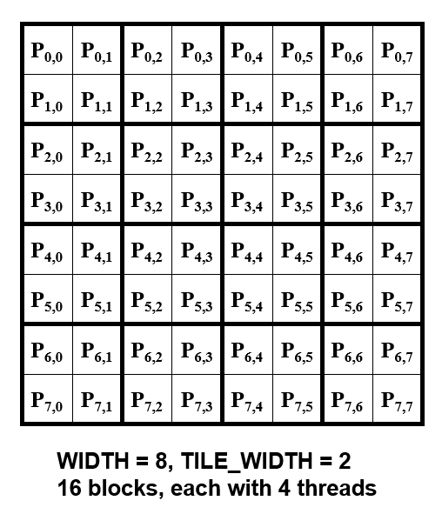
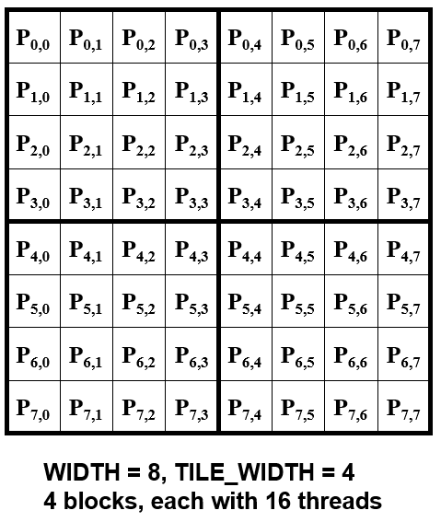
Starting a 2D thread block
Map threads to a matrix P of size WIDTH x WIDTH.
One way is to tile matrix with square thread blocks.
Make blocks of size (TILE_WIDTH x TILE_WIDTH).
Make WIDTH / TILE_WIDTH blocks in each dimension.
Start kernel using
dim3 dimGrid(WIDTH / TILE_WIDTH, WIDTH / TILE_WIDTH, 1);
dim3 dimBlock(TILE_WIDTH, TILE_WIDTH, 1);
MatrixMulKernel<<<dimGrid, dimBlock>>>(args);

Slide 17
2D thread mapping
Map each thread to an element of P, i.e. a row and a column of P.
row = blockId.y * blockDim.y + threadId.y
column = blockId.x * blockDim.x + threadId.x
Ex Thread (2,3) in block (0,1) assigned to column 1*4+3=7, row 0*4+2=2.
Every thread mapped to unique (row, column).
Every element of P assigned some thread.

Slide 18
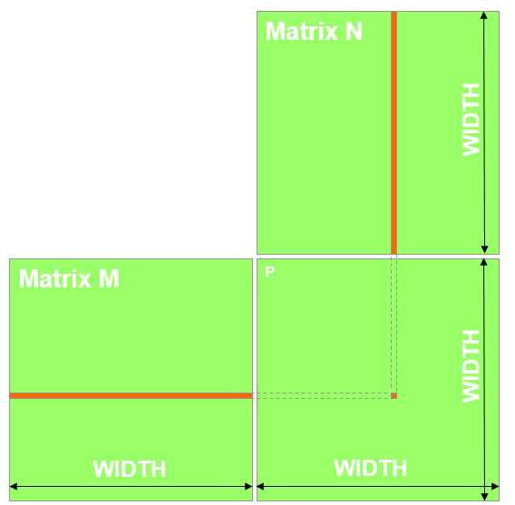
Matrix multiplication
column j
Let M and N be square matrices of size WIDTH. Compute P=M x N.
Can compute in CUDA by mapping one thread to each element in output P.
Thread multiplies elements along a row of M and column of N and sums.
row i
P[i][j]
P[i][j] = sum(M[i][k] * N[k][j])
for k=0,...,n-1

Slide 19
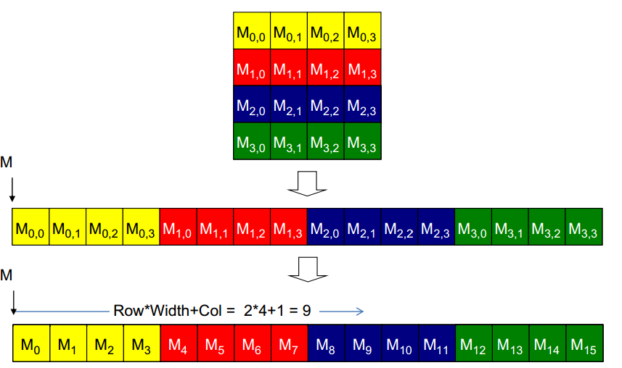
Matrix layout
Before calling kernel, transfer matrix from host to device.
Matrix is represented as 1D array in memory.
C and CUDA use row-major layout, Fortran uses column-major.
For row major, map from 2D index to 1D
(row, col) → row * width + col

Slide 20
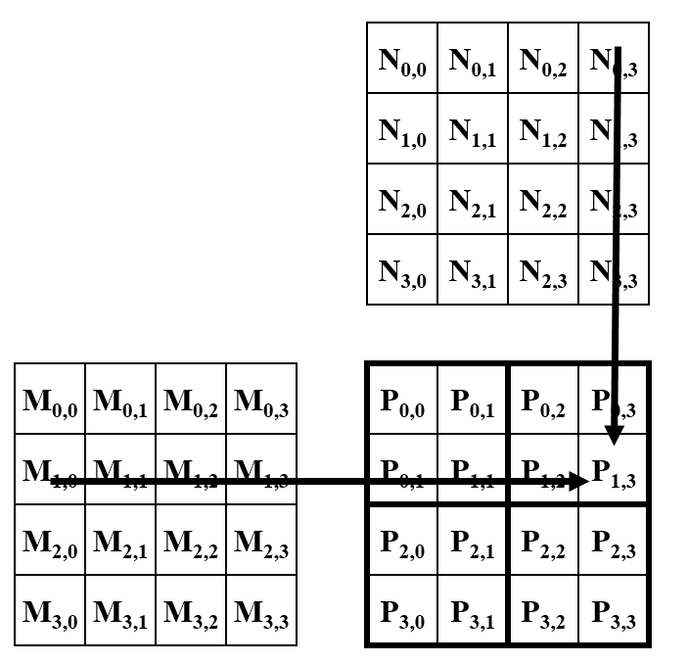
Matrix multiplication
__global__ void MatrixMulKernel(float* d_M, float* d_N, float* d_P, int Width)
{
int Row = blockIdx.y*blockDim.y+threadIdx.y;
int Col = blockIdx.x*blockDim.x+threadIdx.x;
if ((Row < Width) && (Col < Width)) {
float Pvalue = 0;
for (int k = 0; k < Width; ++k)
Pvalue += d_M[Row*Width+k] * d_N[k*Width+Col];
d_P[Row*Width+Col] = Pvalue;
}
}
row = blockId.y * blockDim.y + threadId.y
column = blockId.x * blockDim.x + threadId.x
(row, col) → row * width + col

Slide 21
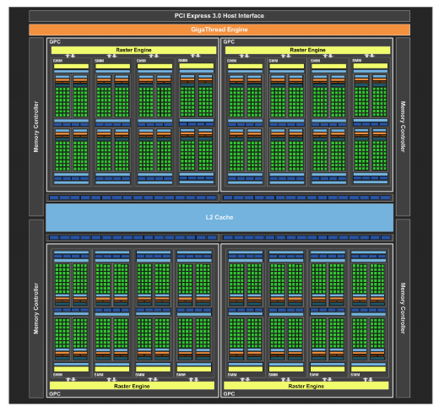
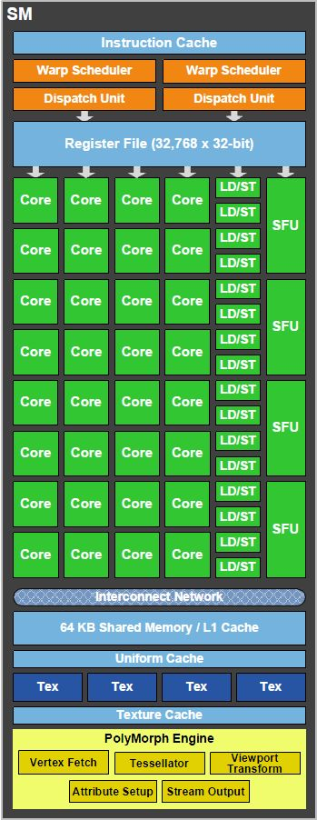
Why two levels of threads?
A grid of thread blocks is easier to manage than one big block of threads.
GPU has 1000’s of cores, grouped into 10’s of streaming multiprocessors (SMs).
Each SM has its own memory, scheduling.
Each SM has e.g. 64 cores (P100 architecture).
GPU can start millions of threads, but they don’t all run simultaneously.
Scheduler (Gigathread Engine) packs up to ~1000 threads into one block and assigns the block to an SM.
The threads have consecutive IDs.
Several thread blocks can be assigned to an SM at same time.
Threads in a block don’t execute simultaneously either.
They run in warps of 32 threads; more later.

Slide 22
Why two levels of threads?
A thread block assigned to an SM uses resources (registers, shared memory) on the SM.
All assigned threads are pre-allocated resources.
Since we know the block size when we invoke the kernel, the SM knows how much resources to assign.
This makes switching between threads very fast.
No dynamic resource allocation.
SM has huge number (e.g. 64K) of registers, so no register flush when switching threads.
Each SM has its own (warp) scheduler to manage threads assigned to it.
When all threads in a block finishes, the resources are freed.
Then Gigathread Engine schedules a new block to the SM, using the freed resources.
At any time, SM only needs to manage a block of a few thousand threads, instead of entire grid of millions of threads.

Slide 23
Synchronization
Different blocks can execute in any order.
Allows CUDA to easily scale to more SMs on higher end GPUs.
Ex For 2 SM GPU, can assign blocks 0,1,2,3,4,5... For 4 SM GPU, assign 0,1,2,3,4,5,6,7...
Drawback is different blocks can’t synchronize, e.g. can’t force block 2 to run after block 1 finishes.
Your code must not depend on a particular block ordering.
Device
Kernel grid
Device
SM
SM
Block 0
Block 1
SM
SM
SM
SM
Block 2
Block 3
Block 4
Block 5
Block 0
Block 1
Block 6
Block 7
Block 0
Block 1
Block 2
Block 3
Block 2
Block 3
time
time
Block 4
Block 5
Block 6
Block 7
Block 4
Block 5
Block 6
Block 7
Source: Programming Massively Parallel Processors: A Hands on Approach. Kirk, Hwu

Slide 24
Synchronization
Suppose you want to synchronize blocks, e.g. make sure some blocks do statement 1 before other blocks do statement 2.
Can only do this by putting 2 statements in different kernels.
Launch first kernel with all blocks doing statement 1.
Then launch second kernel with all blocks doing statement 2.
Kernel launches relatively expensive, so this is an expensive form of synchronization.
Threads within a block can do barrier synchronization using __syncthreads().
More on this in later lecture.

Slide 25
Choosing the right block size
Ex In matrix multiplication, should we use 8x8, 16x16 or 32x32 blocks?
This is based on 3 main considerations.
Goal Maximize number of simultaneously active threads (occupancy) on each SM.
More on reasons why next time.
Consideration 1 Must satisfy several hardware constraints.
Following numbers are examples.
≤ 1536 threads assigned to an SM at once.
≤ 8 blocks assigned to an SM at once.
≤ 512 threads per block.
If 8x8 blocks, then 64 threads/block. Need 1536 / 64 = 12 blocks to fully occupy SM. Too many blocks.
If 16x16 blocks, then 256 threads/block. Use 6 blocks to occupy SM. OK.
If 32x32 blocks, then 1024 threads/block. Too many threads per block.

Slide 26
Choosing the right block size
Consideration 2 The complexity of each thread.
Suppose each SM has 16K registers, and each thread uses 20 registers.
If 256 threads / block, each block uses 5120 registers.
Can run 3 blocks = 768 threads. 50% occupancy, since SM can run 1536 threads.
If 512 threads / block, each block uses 10240 regs.
Can run only 1 block = 512 threads. 33% occupancy.
Nvidia provides a “CUDA Occupancy Calculator” to help calculate number of runnable threads based on your kernel and hardware.

Slide 27
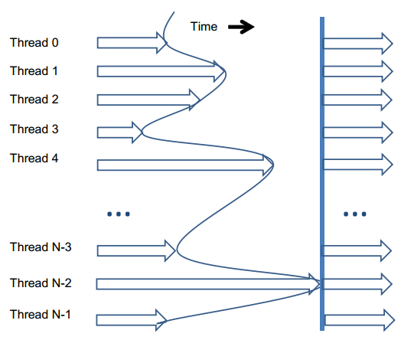
Choosing the right block size
Consideration 3 Thread work imbalance.
Scheduler only frees block from SM when all threads in block finish.
With big blocks, more likely to have straggler threads.
Even though threads run same code, due to branching some code paths can be longer.
Stragglers prevent SM resources from being freed.
But they also don’t occupy the SM, leading to waste.
With smaller blocks, more likely threads finish at similar times. Less waste.
Barrier synchronization within block can also cause threads to wait for each other, i.e. waste.

Slide 28
Finding hardware parameters
Hardware parameters saw change over time. To get parameters for your device, use:
cudaDeviceProp dev_prop;
cudaGetDeviceProperties(&dev_prop, 1)
dev_prop.maxThreadsPerBlock
dev_prop.multiProcessorCount // how many total SMs
dev_prop.maxThreadsDim[i] // i = 0,1,2 for x,y,z
dev_prop.maxGridSize[i] // i = 0,1,2 for x,y,z
dev_prop.clockRate
Many other parameters. See CUDA Programming Guide.

